Slide 1
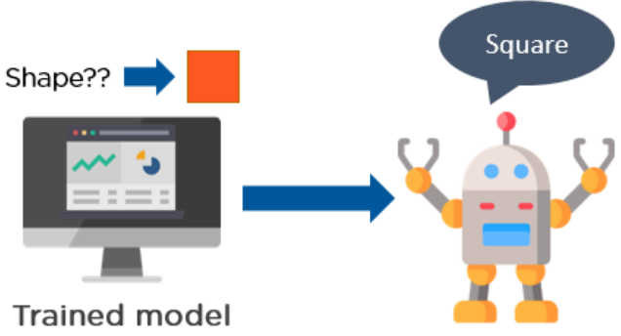
Reinforcement Learning
Reinforcement Learning trains a machine to take suitable actions and maximize its rewards in a particular situation. It uses an agent and an environment to produce actions and rewards. The agent has a start and an end state. But, there might be different paths for reaching the end state, like a maze. In this learning technique, there is no predefined target variable.
An example of reinforcement learning is
to train a machine that can identify the
shape of an object, given a list of different
objects. In the example shown, the model
tries to predict the shape of the object,
which is a square in this case.

Slide 2
Working
Reinforcement learning follows trial and error methods to get the desired result. After accomplishing a task, the agent receives an award. An example could be to train a dog to catch the ball. If the dog learns to catch a ball, you give it a reward, such as a biscuit.
Reinforcement Learning methods do not need any external supervision to train models.
Reinforcement learning problems are reward-based. For every task or for every step completed, there will be a reward received by the agent. If the task is not achieved correctly, there will be some penalty added.
Reinforcement learning algorithms are widely used in the gaming industries to build games. It is also used to train robots to do human tasks.

Slide 3
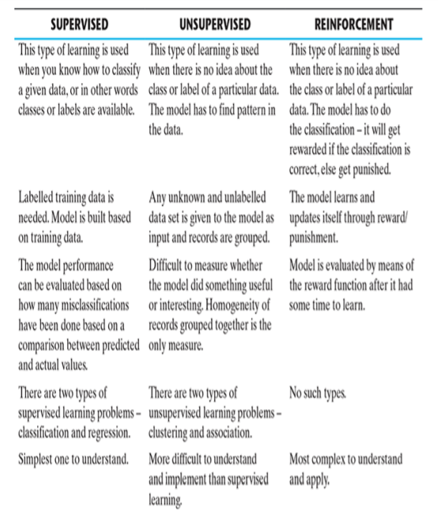
Comparison – supervised, unsupervised, and reinforcement learning

Slide 4
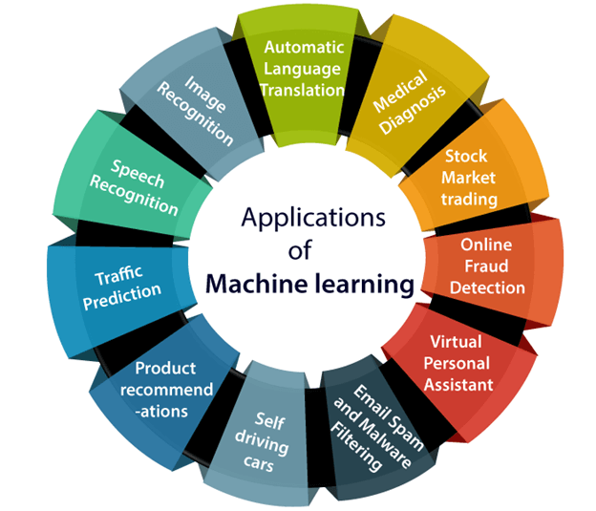
Applications of Machine learning
Machine learning is a buzzword for today's technology, and it is growing very rapidly day by day.
We are using machine learning in our daily life even without knowing it such as Google Maps, Google assistant, Alexa, etc.
Below are some most trending real-world applications of Machine Learning:

Slide 5
1. Image Recognition:
Image recognition is one of the most common applications of machine learning. It is used to identify objects, persons, places, digital images, etc. The popular use case of image recognition and face detection is, Automatic friend tagging suggestion:
Facebook provides us a feature of auto friend tagging suggestion. Whenever we upload a photo with our Facebook friends, then we automatically get a tagging suggestion with name, and the technology behind this is machine learning's face detection and recognition algorithm.
It is based on the Facebook project named "Deep Face," which is responsible for face recognition and person identification in the picture.

Slide 6
2. Speech Recognition
While using Google, we get an option of "Search by voice," it comes under speech recognition, and it's a popular application of machine learning.
Speech recognition is a process of converting voice instructions into text, and it is also known as "Speech to text", or "Computer speech recognition." At present, machine learning algorithms are widely used by various applications of speech recognition. Google assistant, Siri, Cortana, and Alexa are using speech recognition technology to follow the voice instructions.

Slide 7
3. Traffic prediction
If we want to visit a new place, we take help of Google Maps, which shows us the correct path with the shortest route and predicts the traffic conditions.
It predicts the traffic conditions such as whether traffic is cleared, slow-moving, or heavily congested with the help of two ways:
Real Time location of the vehicle form Google Map app and sensors
Average time has taken on past days at the same time.
Everyone who is using Google Map is helping this app to make it better. It takes information from the user and sends back to its database to improve the performance.

Slide 8
4. Product recommendations
Machine learning is widely used by various e-commerce and entertainment companies such as Amazon, Netflix, etc., for product recommendation to the user. Whenever we search for some product on Amazon, then we started getting an advertisement for the same product while internet surfing on the same browser and this is because of machine learning.
Google understands the user interest using various machine learning algorithms and suggests the product as per customer interest.
As similar, when we use Netflix, we find some recommendations for entertainment series, movies, etc., and this is also done with the help of machine learning.

Slide 9
5. Self-driving cars
One of the most exciting applications of machine learning is self-driving cars.
Machine learning plays a significant role in self-driving cars. Tesla, the most popular car manufacturing company is working on self-driving car.
It is using unsupervised learning method to train the car models to detect people and objects while driving.

Slide 10
6. Email Spam and Malware Filtering
Whenever we receive a new email, it is filtered automatically as important, normal, and spam. We always receive an important mail in our inbox with the important symbol and spam emails in our spam box, and the technology behind this is Machine learning. Below are some spam filters used by Gmail:
Content Filter
Header filter
General blacklists filter
Rules-based filters
Permission filters
Some machine learning algorithms such as Multi-Layer Perceptron, Decision tree, and Naïve Bayes classifier are used for email spam filtering and malware detection.

Slide 11
7. Virtual Personal Assistant
We have various virtual personal assistants such as Google assistant, Alexa, Cortana, Siri. As the name suggests, they help us in finding the information using our voice instruction. These assistants can help us in various ways just by our voice instructions such as Play music, call someone, Open an email, Scheduling an appointment, etc.
These virtual assistants use machine learning algorithms as an important part.
These assistant record our voice instructions, send it over the server on a cloud, and decode it using ML algorithms and act accordingly.

Slide 12
8. Online Fraud Detection
Machine learning is making our online transaction safe and secure by detecting fraud transaction. Whenever we perform some online transaction, there may be various ways that a fraudulent transaction can take place such as fake accounts, fake ids, and steal money in the middle of a transaction. So to detect this, Feed Forward Neural network helps us by checking whether it is a genuine transaction or a fraud transaction.
For each genuine transaction, the output is converted into some hash values, and these values become the input for the next round. For each genuine transaction, there is a specific pattern which gets change for the fraud transaction hence, it detects it and makes our online transactions more secure.

Slide 13
9. Stock Market trading
Machine learning is widely used in stock market trading. In the stock market, there is always a risk of up and downs in shares, so for this machine learning's long short term memory neural network is used for the prediction of stock market trends.

Slide 14
10. Medical Diagnosis
In medical science, machine learning is used for diseases diagnoses. With this, medical technology is growing very fast and able to build 3D models that can predict the exact position of lesions in the brain.
It helps in finding brain tumors and other brain-related diseases easily.

Slide 15
11. Automatic Language Translation
Nowadays, if we visit a new place and we are not aware of the language then it is not a problem at all, as for this also machine learning helps us by converting the text into our known languages. Google's GNMT (Google Neural Machine Translation) provide this feature, which is a Neural Machine Learning that translates the text into our familiar language, and it called as automatic translation.
The technology behind the automatic translation is a sequence to sequence learning algorithm, which is used with image recognition and translates the text from one language to another language.

Slide 16
TOOLS IN MACHINE LEARNING
The algorithms related to different machine learning tasks are known to all and can be implemented using any language/platform. It can be implemented using a Java platform or C / C++ language or in .NET. However, there are certain languages and tools which have been developed with a focus for implementing machine learning. Few of them, which are most widely used, are covered below.
Python
R
Matlab
SAS

Slide 17
Python
Python is one of the most popular, open source programming language widely adopted by machine learning community.
It was designed by Guido van Rossum and was first released in 1991.
Python has very strong libraries for advanced mathematical functionalities (NumPy), algorithms and mathematical tools (SciPy) and numerical plotting (matplotlib).
Built on these libraries, there is a machine learning library named scikit-learn, which has various classification, regression, and clustering algorithms embedded in it.

Slide 18
R
R is a language for statistical computing and data analysis.
It is an open source language, extremely popular in the academic community – especially among statisticians and data miners.
R is considered as a variant of S, a GNU project which was developed at Bell Laboratories.
Currently, it is supported by the R Foundation for statistical computing.
R is a very simple programming language with a huge set of libraries available for different stages of machine learning.
Some of the libraries standing out in terms of popularity are plyr/dplyr (for data transformation), caret (‘Classification and Regression Training’ for classification), RJava (to facilitate integration with Java), tm (for text mining), ggplot2 (for data visualization).
Other than the libraries, certain packages like Shiny and R Markdown have been developed around R to develop interactive web applications, documents and dashboards on R without much effort.

Slide 19
Matlab
MATLAB (matrix laboratory) is a licenced commercial software with a robust support for a wide range of numerical computing.
MATLAB has a huge user base across industry and academia.
MATLAB is developed by MathWorks, a company founded in 1984.
MATLAB also provides extensive support of statistical functions and has a huge number of machine learning algorithms in-built.
It also has the ability to scale up for large datasets by parallel processing on clusters and cloud.

Slide 20
SAS
SAS (earlier known as ‘Statistical Analysis System’) is another licenced commercial software which provides strong support for machine learning functionalities.
Developed in C by SAS Institute, SAS had its first release in the year 1976.
SAS is a software suite comprising different components.
The basic data management functionalities are embedded in the Base SAS component whereas the other components like SAS/INSIGHT, Enterprise Miner, SAS/STAT, etc. help in specialized functions related to data mining and statistical analysis.

Slide 21
ISSUES IN MACHINE LEARNING
Machine learning is a field which is relatively new and still evolving.
Also, the level of research and kind of use of machine learning tools and technologies varies drastically from country to country.
The laws and regulations, cultural background, emotional maturity of people differ drastically in different countries.
All these factors make the use of machine learning and the issues originating out of machine learning usage are quite different.
The biggest fear and issue arising out of machine learning is related to privacy and the breach of it.

Slide 22
The primary focus of learning is on analyzing data, both past and current, and coming up with insight from the data.
This insight may be related to people and the facts revealed might be private enough to be kept confidential.
Also, different people have a different preference when it comes to sharing of information.
While some people may be open to sharing some level of information publicly, some other people may not want to share it even to all friends and keep it restricted just to family members.

Slide 23
Classic examples are a birth date (not the day, but the date as a whole), photographs of a dinner date with family, educational background, etc.
Some people share them with all in the social platforms like Facebook while others do not, or if they do, they may restrict it to friends only.
When machine learning algorithms are implemented using those information, inadvertently people may get upset.
For example, if there is a learning algorithm to do preference-based customer segmentation and the output of the analysis is used for sending targeted marketing campaigns, it will hurt the emotion of people and actually do more harm than good.
In certain countries, such events may result in legal actions to be taken by the people affected.

Slide 24
Even if there is no breach of privacy, there may be situations where actions were taken based on machine learning may create an adverse reaction.
Let’s take the example of knowledge discovery exercise done before starting an election campaign.
If a specific area reveals an ethnic majority or skewness of a certain demographic factor, and the campaign pitch carries a message keeping that in mind, it might actually upset the voters and cause an adverse result.
So a very critical consideration before applying machine learning is that proper human judgement should be exercised before using any outcome from machine learning.
Only then the decision taken will be beneficial and also not result in any adverse impact.

